Slide 1




Slide 2

JAVA INTRODUCTION, FEATURES, STRUCTURE, DATA TYPE

Slide 3
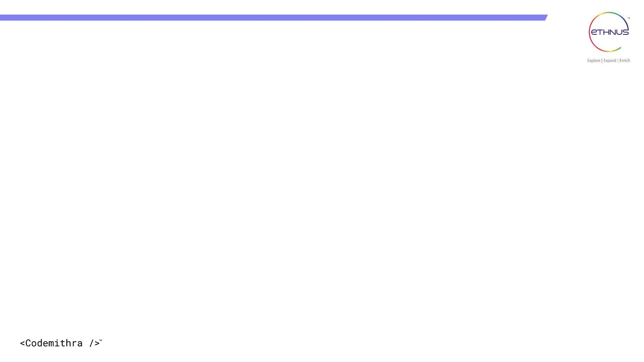

TOPICS
Introduction Of Java
Where We Used
History Of Java
Latest Version
Feature Of Java
Java Structure
Components Of Java
Pros and Cons
Data types

Slide 4
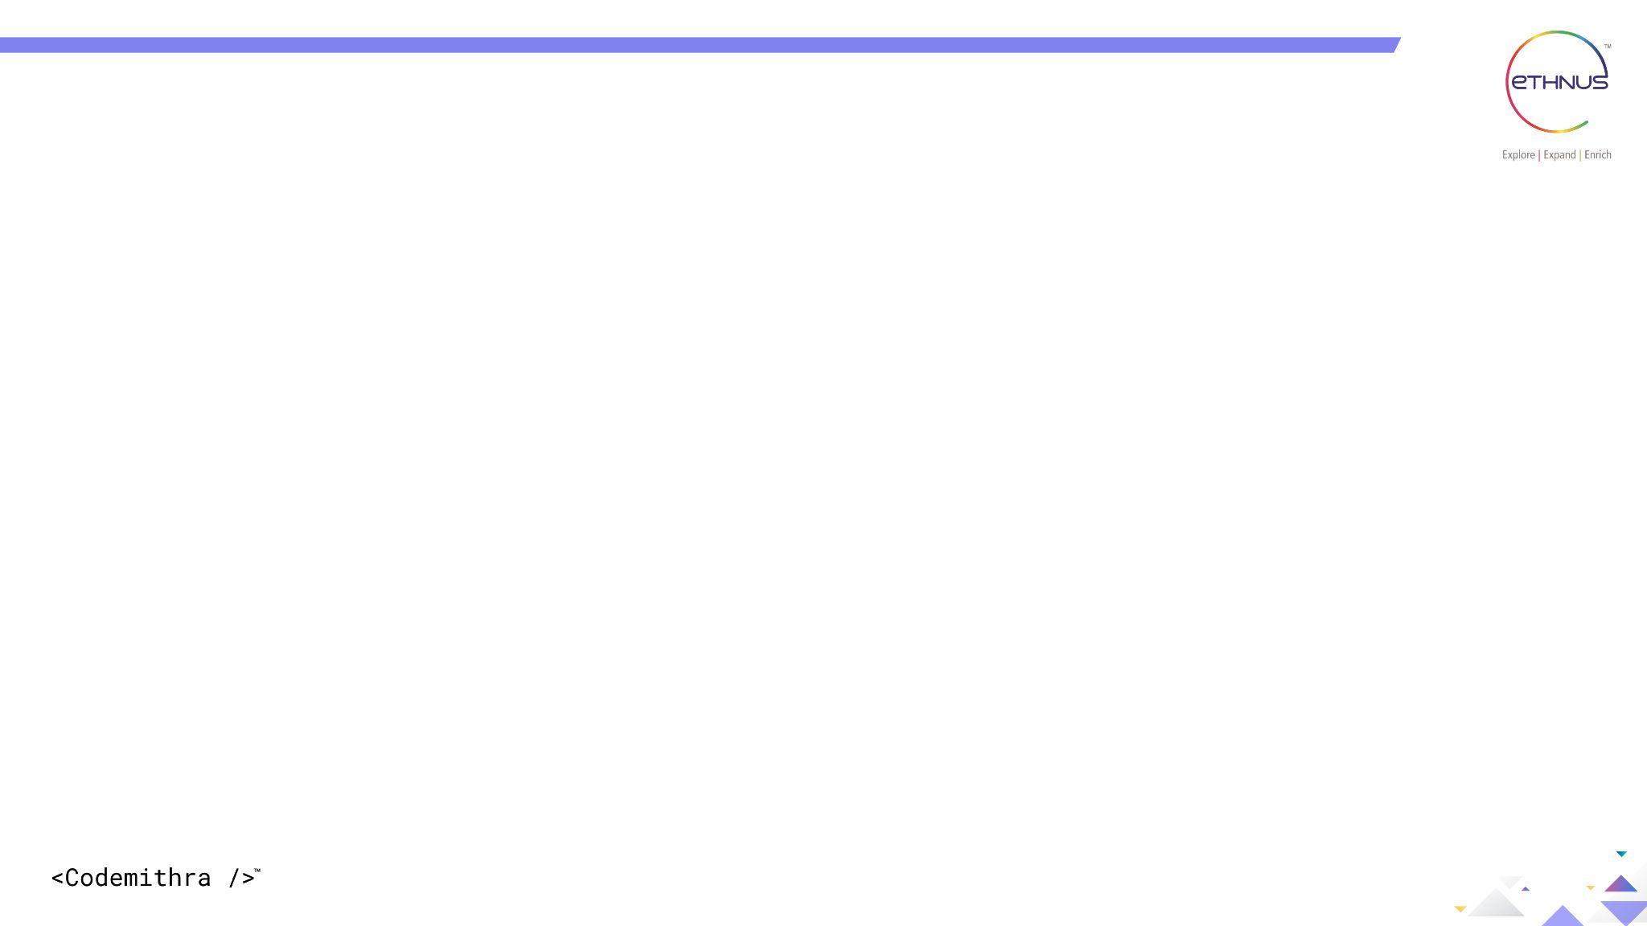
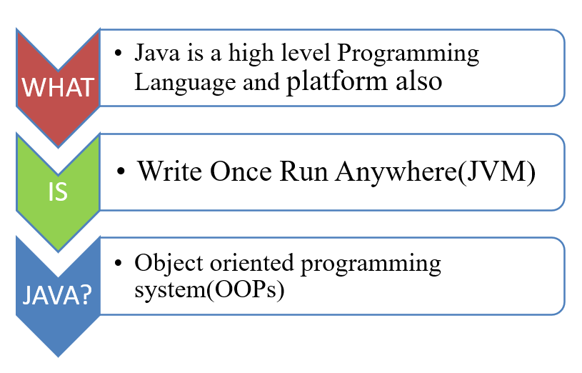
Introduction Of Java

Slide 5
Where We Used
Desktop Applications
Mobile Applications
Enterprise Applications
Web-based Applications
Gaming Applications

Slide 6
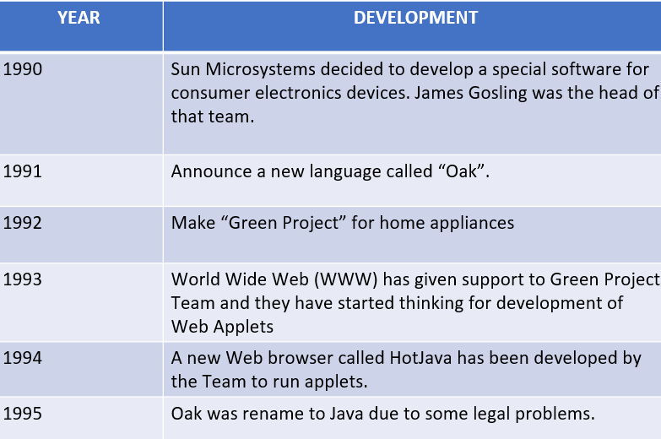
+
History

Slide 7
+
Latest Version
JDK developed from 1995 onwards
Currently we are using Java SE 19.0.1 released by Java SE Platform
Released in September,2022
May be March,2023, Java 20 will follow

Slide 8
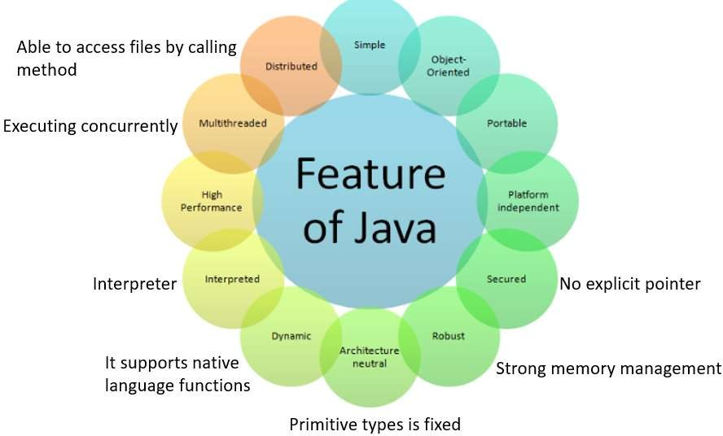
+
Features

Slide 9
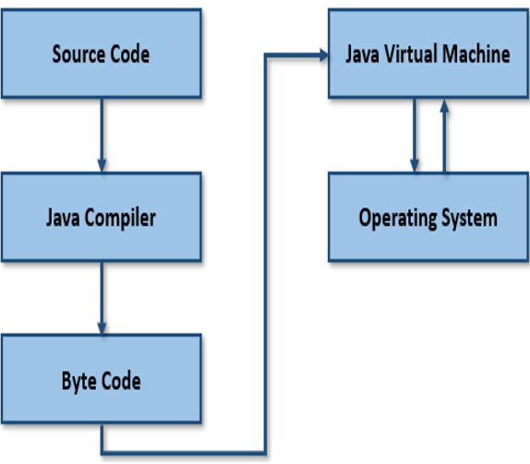
Structure

Slide 10
Components
There are three main components of Java language:
JVM(java Virtual Machine)
JRE(Java Runtime Environment)
JDK(Java Development Kit)

Slide 11
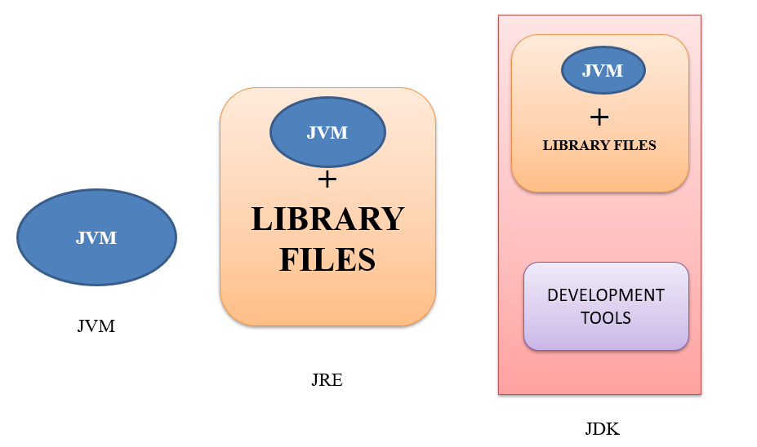
JVM,JRE,JDK

Slide 12
JVM
JVM interprets the byte code into machine code which is executed
in the machine in which the Java program runs. Virtual manner.
Platform independent.
The JVM performs following main tasks:
⮚Loads code
⮚Verifies code
⮚Executes code
⮚Provides runtime environment

Slide 13
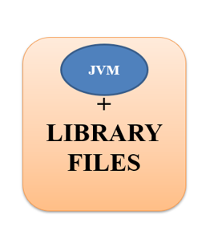
JRE
⮚It is used to provide runtime environment. It is the implementation of JVM.
⮚It physically exists.
⮚It contains set of libraries + other files that JVM uses at runtime.
⮚Must need to run a program

Slide 14
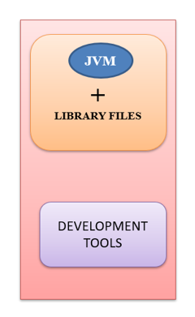
JDK
The Java Development Kit (JDK) is physically exists.
It contains JRE and several development tools, accompanied with another tool.
Tools examples
⮚Java compiler
⮚Java doc
⮚Applet viewer

Slide 15
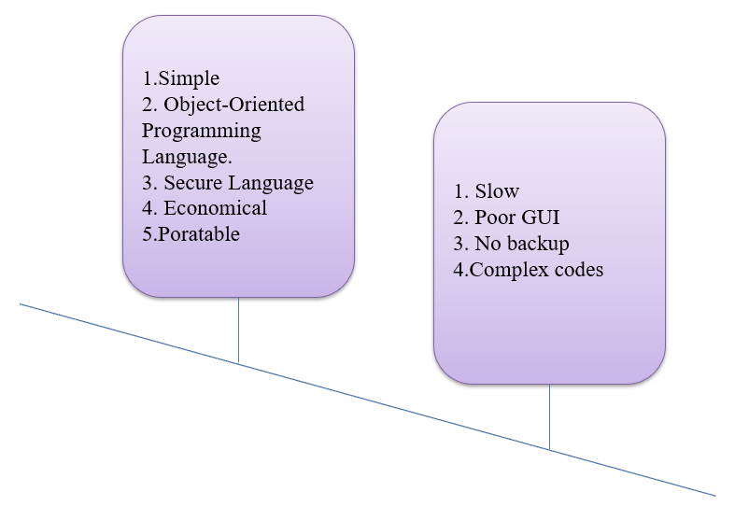
Pros and Cons

Slide 16
Data types
Data is the information that a program has to work with.
Data is of different types. The type of a piece of data tells Java what can be done with it, and how much memory needs to be put aside for it.
When we create a variable in Java, we need to specify:
the type of the value we want to put in there
the name we will use for that variable.

Slide 17
Data types
A variable must be declared, specifying the variable's name and the type of information that will be held in it
data type
variable name
int total;
int count, temp, result;
Multiple variables can be created in one declaration
int count=1, temp=0;
Variables can also be given initial values

Slide 18
Data types
data types are classified into two types and they are as follows.
Primitive Data Types
Non-primitive Data Types

Slide 19
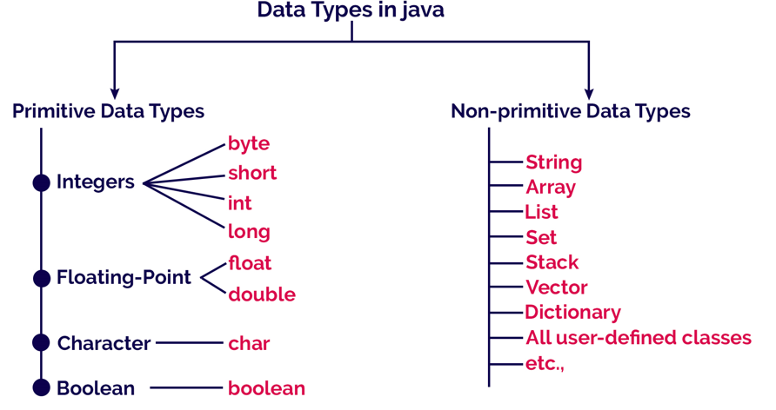
Data types

Slide 20
Data types
The primitive data types are built-in data types and they specify the type of value stored in a variable and the memory size.
The primitive data types do not have any additional methods.
In Java, primitive data types include
Byte
Short
Int
Long
Float
Double
Char
boolean

Slide 21
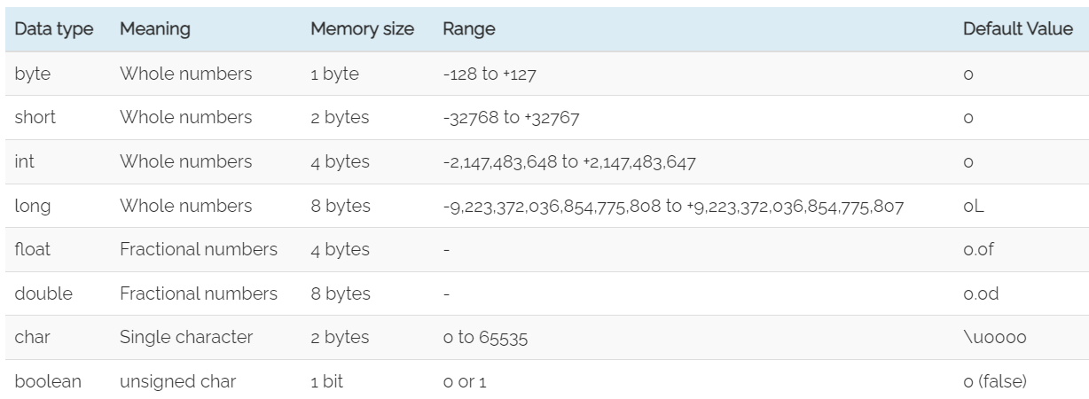
Data types

Slide 22
Data types
Non-Primitive Data Type
Strings: String is a sequence of characters. But in Java, a string is an object that represents a sequence of characters. The java.lang.String class is used to create a string object.
Arrays: Arrays in Java are homogeneous data structures implemented in Java as objects. Arrays store one or more values of a specific data type and provide indexed access to store the same. A specific element in an array is accessed by its index.
Non-Primitive
strings
arrays
classes
interface

Slide 23
Data types
Classes: A class in Java is a blueprint which includes all your data. A class contains fields(variables) and methods to describe the behavior of an object.
Interface: Like a class, an interface can have methods and variables, but the methods declared in interface are by default abstract (only method signature, no body).
Non-Primitive
strings
arrays
classes
interface

Slide 24
INTERVIEW QUESTIONS

Slide 25
Interview questions
What is Java, and what are its key features?
Java is a high-level, object-oriented programming language developed by Sun Microsystems (now owned by Oracle). Some key features of Java include platform independence (write once, run anywhere), automatic memory management (garbage collection), robustness, portability, and support for multithreading.

Slide 26
Interview questions
What are the primitive data types in Java?
Java has eight primitive data types byte, short, int, long, float, double, char, and boolean. These data types represent basic values and are not objects like other reference types.

Slide 27
Interview questions
What is the difference between primitive data types and reference data types in Java?
The main difference is that primitive data types store the actual value, whereas reference data types store a reference (memory address) to the object's location. Primitive data types are predefined by the language, while reference data types are created using classes.

Slide 28
Interview questions
How is memory managed in Java?
Java uses automatic memory management through a process called garbage collection. When an object is no longer referenced or reachable, the garbage collector identifies it and reclaims the memory occupied by that object, freeing developers from manual memory management.

Slide 29
Interview questions
Explain the Java Virtual Machine (JVM) and its role in Java's architecture.
JVM is the cornerstone of Java's platform independence. It acts as an abstract machine that interprets Java bytecode, which is generated from the source code. JVM translates the bytecode into machine code specific to the underlying operating system and hardware, allowing Java programs to run on any platform with a compatible JVM implementation.

Slide 30
Interview questions
How does Java achieve platform independence?
Java achieves platform independence through the "Write Once, Run Anywhere" (WORA) concept. Java source code is compiled into platform-independent bytecode, which is executed by the JVM. Since JVM implementations are available for various platforms, Java programs can run on any system with a compatible JVM, regardless of the underlying architecture.

Slide 31
Interview questions
What is the Java Development Kit (JDK)?
The JDK is a software development kit provided by Oracle (previously Sun Microsystems) that includes tools, executables, and libraries necessary for developing, compiling, and running Java applications. It contains the Java Compiler (javac), Java Virtual Machine (JVM), and various utility tools.

Slide 32
Interview questions
Explain the main components of Java's architecture.
Java's architecture consists of three main components the Java Development Kit (JDK) for development, the Java Runtime Environment (JRE) for executing Java applications, and the Java Application Programming Interface (API) for building Java applications using pre-defined classes and libraries.

Slide 33
Interview questions
How does Java support multithreading, and why is it beneficial?
Java supports multithreading through its built-in Thread class and the Runnable interface. Multithreading allows concurrent execution of multiple threads within the same Java program. This is beneficial for improving performance and responsiveness in applications that involve tasks that can be executed independently and concurrently.

Slide 34
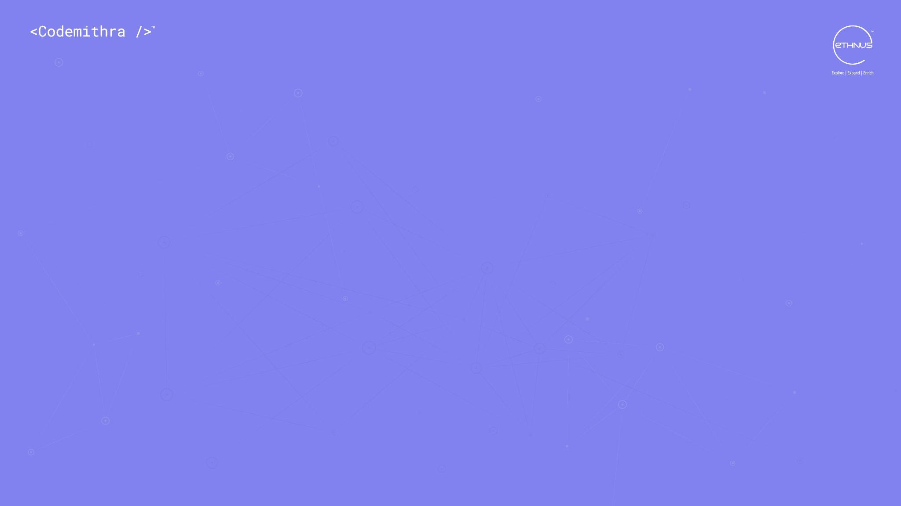



THANK YOU
+91 78150 95095
codemithra@ethnus.com
www.codemithra.com

